Slide 1

Bangladesh Army University of Science And Technology
Project Name: Job Board Website
Submitted By:
Iffat Ara Snigdha (0802310105101075)
Ummay Hafsa Efty(0802310105101082)
Md. Shalakurjjaman (0802310405101086)
Md.Rajit Tahiyat (0802310405101066)
Submitted To:
Hasan Muhammad Kafi
Assistant Professor
Dept. of CSE,BAUST

Slide 2

Outline
1
Introduction
2
Motivation
3
Problem Definition
4
Objective
5
Features
6
Workflow
Tools and Technology
7
Conclusion
8

Slide 3
Introduction
Overview
Purpose
Developing a job board website to connect employers with job seekers.
Connect job seekers with employers.
Scope
Develop a website with user authentication, job posting, job search, and application features.

Slide 4
Motivation
1
Job Seeker Benefits
2
Employer Benefits
Find all job listings in one place.
Manage job listings from a single platform.
3
Growing Job Market
Increasing reliance on digital platforms for job recruitment.

Slide 5
Problem Definition
Job Seekers Challenges
Employers Challenges
Manual Recruitment
Difficulty finding relevant jobs across multiple sites.
Inefficient management of job postings and applications.
Not having complete and unified solutions

Slide 6
Objective
1
Develop a Job Board
Create a platform for job listings and applications
2
Implement Key Features
User registration and login, job posting, job search, application submission.
3
Ensure Usability
Provide a user-friendly interface for both job seekers and employers

Slide 7




Features
Job Search
Application Process
Search by keywords, location, and job type.
Apply for jobs and upload resumes.
User Authentication
Job Posting
Secure registration and login for job seekers and employers.
Create, update, and delete job listings.

Slide 8
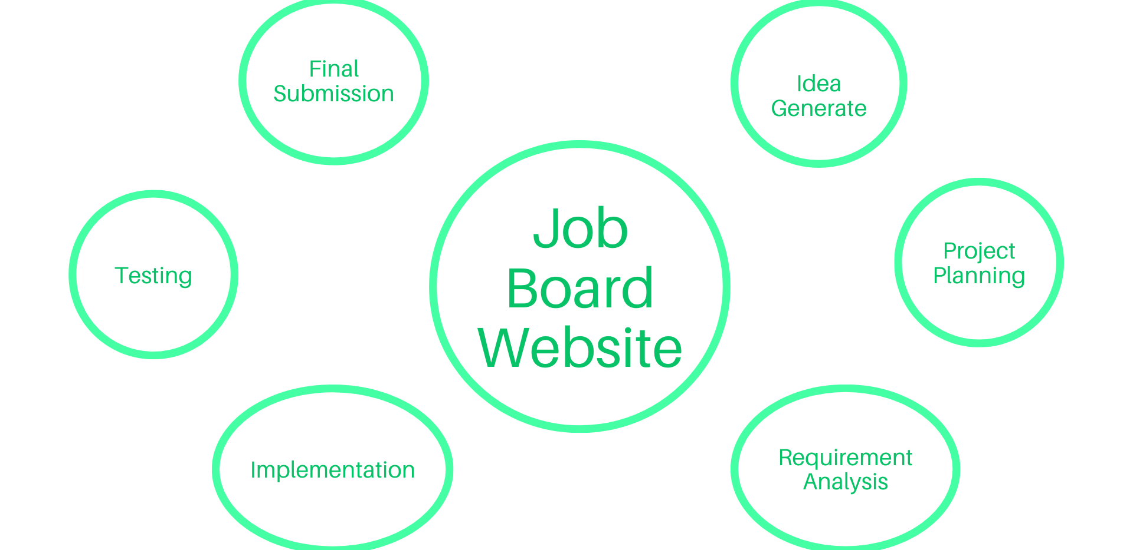
Workflow

Slide 9



Tools & Technology
MySQL
PHP
Relational database management system for storing and managing data.
Server-side scripting language for website development.
HTML
CSS
Markup language for structuring the website's content.
Styling language for enhancing the website's visual appearance.

Slide 10



Conclusion
Goal
Develop a comprehensive job board website.
Impact
Positive impact on both job seekers and employers.
Future Work
Features like advanced search, email notifications, and mobile responsiveness.

Slide 11
Thank You

Slide 12
Any Question?

